Slide 1

Group: 4 Student name: enrolment number Akash Mane: 3105253 Pujitha Peri: 3103755 Suraj Naik: 3105252 Trisha: 3104921
Final project presentation using Python
Emotion Recognition from Video
Big Data group
Nov.12.2019

Slide 2
Emotion Recognition from Video
Emotion recognition systems based on facial gesture enable real-time analysis, tagging, and inference of cognitive affective states from a video recording of the face.
Movements in facial muscles are perceived as changes in the position of the eyes, nose, and mouth. Computer systems implement this approach by capturing images of the user’s facial expressions and head movements.
Those systems detect changes in the position of the eyes, nose, and mouth as changes in the position of dots in a coordinate system. Then, by analyzing those changes, the occurrence of a facial action unit can be determined.
A face emotion recognition system comprises of two step process i.e. face detection (bounded face) in image followed by emotion detection on the detected bounded face.
To achieve the task at hand we have used “Convolution Neural Network”

Slide 3
Keras
Keras is an open source neural network library written in Python.
Keras is designed to enable fast experimentation with deep neural networks. It focusses on being user friendly and modular and hence easy to use.
Keras doesn't handle low-level computation. Instead, it uses another library to do it, called the "Backend”.
Keras Backend, performs all low-level computation such as tensor products, convolutions and many other things with the help of other libraries such as TensorFlow or Theano. TensorFlow is the default "backend engine" but we can change it in the configuration.
Keras is supported by variety of devices - iOS with Core ML, Android with Tensorflow Android, Web browser with .js support, Cloud engine, Raspberry Pi.
Keras has a built-in support for data parallelism, which allows it to train on single GPU or use multiple GPUs at once. So it can process large volumes of data and speed up the time needed to train.
Keras only handles high-level API, so it's not very useful if you want to make your own abstract layer for your research purposes as it has its own pre-configured layers.

Slide 4

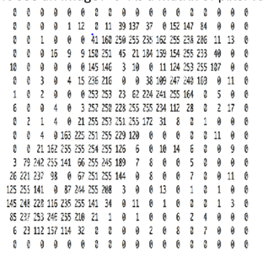
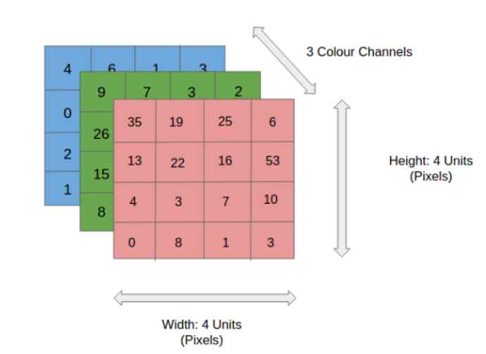
How Computer Reads an Image?
How do computers see an image? 🡪 As a matrix of pixel values.
A typical image, have 3 channels representing colours -red, green and blue (RGB), each colour is represented as a 2-d matrix which are stacked over each other. On the other hand, the grayscale image has just one channel with one 2-d matrix representation of the image. The pixel values range from 0-255, for a grayscale 0 represents black and 255 represents white.

Slide 5
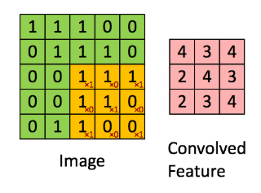
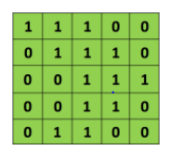

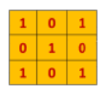
Convolution Neural Network
There are four main operations in the CNN:
1. Convolution: We extract features from the input image, preserves the spatial relationship between pixels by learning image features using small squares of input data.
The 3x3 matrix is called the filter/Kernel/Feature Detector, and the matrix formed by applying the filter over the image and computing the dot product is called the ‘Convolved Feature’ or ‘Activation Map’ or the ‘Feature Map‘. The more number of filters we have, the more image features get extracted and the better our network becomes at recognizing patterns in unseen images.

Slide 6
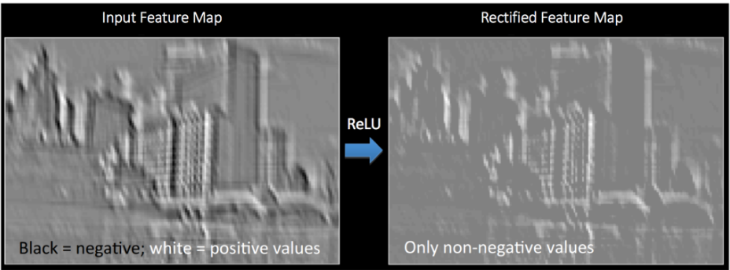
Convolution Neural Network
2. Activation Function (ReLU) - ReLU stands for Rectified Linear Unit and is a non-linear operation. It perform element wise operation (applied per pixel) and replaces all negative pixel values in the feature map by zero. - The output is given by = max(0,Input) . - The purpose of ReLU is to introduce non-linearity in our CNN, since most of the real-world data we would want our CNN to learn would be non-linear. - The ReLU operation is applied to one of the feature maps obtained from the Convolution step and generates a new map referred as the ‘Rectified’ feature map.

Slide 7
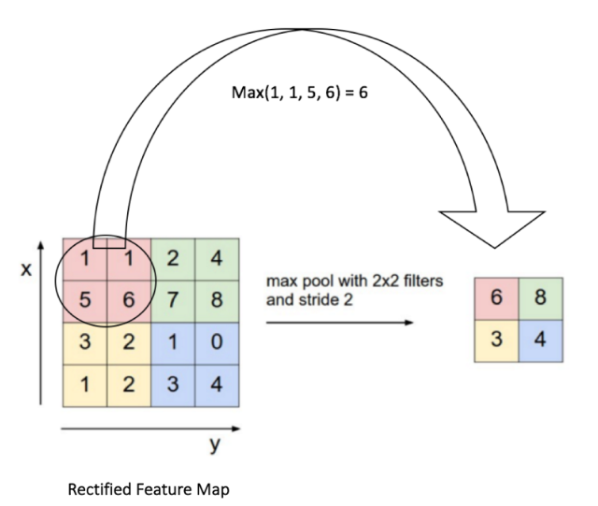
Convolution Neural Network
3. The Pooling Step
- In this step we reduce the dimensionality of the Feature map, retaining the most important information. Spatial Pooling can be of different types: Max, Average, Sum etc.
- In case of Max Pooling, we define a spatial neighborhood for example, a 2×2 stride) and take the largest element from the rectified feature map. - In case of Average Max Pooling, we define a spatial neighborhood (for example, a 2×2 window) and take the average elements from the rectified feature map.
The function of Pooling is to progressively reduce the spatial size of the input representation. In particular, pooling - makes the feature dimensions smaller and manageable.
- reduces the number of parameters and computations in the network, therefore, controlling overfitting.
- makes the network invariant to small transformations, distortions and translations in the input image. - helps us arrive at an almost scale invariant representation of our image, as it help us to detect objects in an image no matter where they are located.

Slide 8
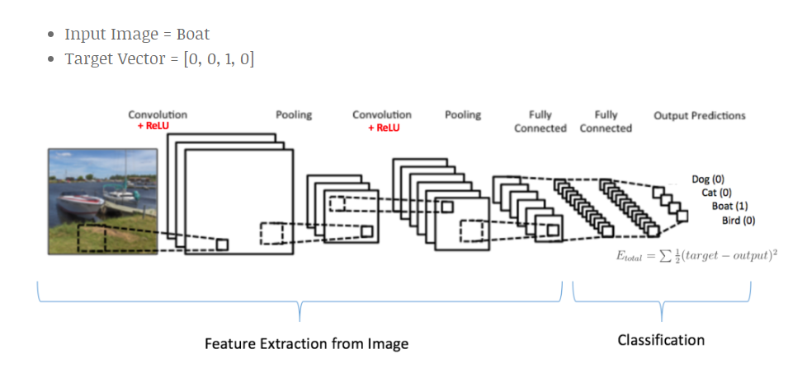
Convolution Neural Network
4. Fully Connected Layer:
- The output of the 2nd Pooling Layer acts as an input to the Fully Connected Layer.
- The Fully Connected layer is a Multi Layer Perceptron, which uses softmax activation function in the output layer. It implies that every neuron from the previous layer is connected to the next layer.
- The output from the convolutional and pooling layers represent high-level features of the input image. The purpose of the Fully Connected layer is to use these features for classifying the input image into various classes based on the training dataset.
- The Softmax function ensures that the sum of output probabilities from a Fully Connected layer is 1.
Conclusion: The Convolution + Pooling layers act as “Feature Extractors” from the input image and the Fully Connected layer acts as a “classifier”.

Slide 9
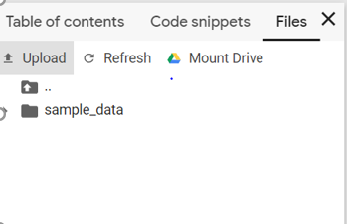
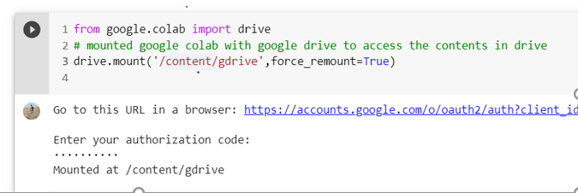
Dataset & Mounting on Google drive
Kaggle Data-Set : No. of rows :35,888 ; No. of columns: 3 (emotion, pixels, usage).
We have uploaded the Kaggle dataset on our google drive . Launch colab 🡪 goto Files🡪 Click on Mount Drive🡪 Run the Command🡪 a link will be populated🡪 Click on the link and copy the “Authorization” code 🡪 paste the code in the colab 🡪 Refresh the File 🡪 Your drive will be loaded.
To get the path of the file 🡪 Right on the required file 🡪 Click on copy path.
0 | 1 | 2 | 3 | 4 | 5 | 6
Angry | Disgust | Fear | Happy | Sad | Surprise | Neutral

Slide 10
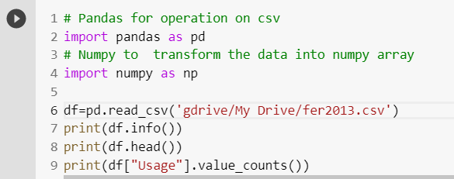
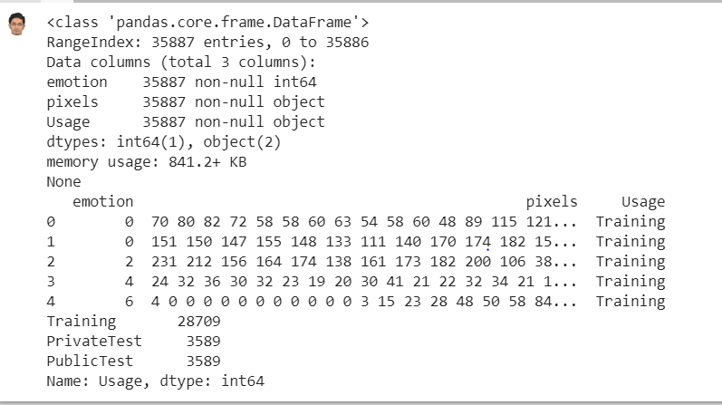
Understanding and Loading Dataset
It gives information about the csv file: datatype
columns, headings, no. of rows.
Display the first five row.
Display the count of category in usage columns

Slide 11
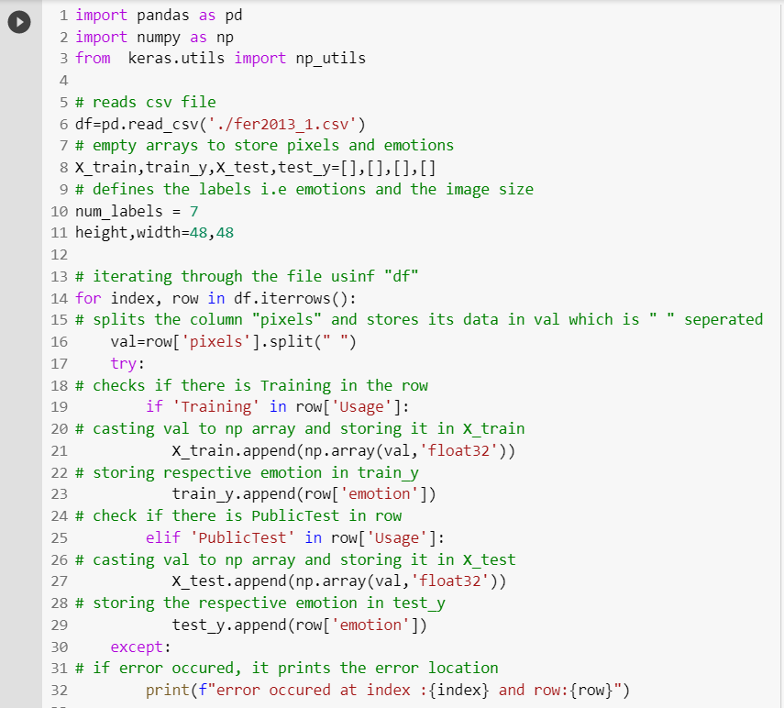
Loading the Data Set

Slide 12
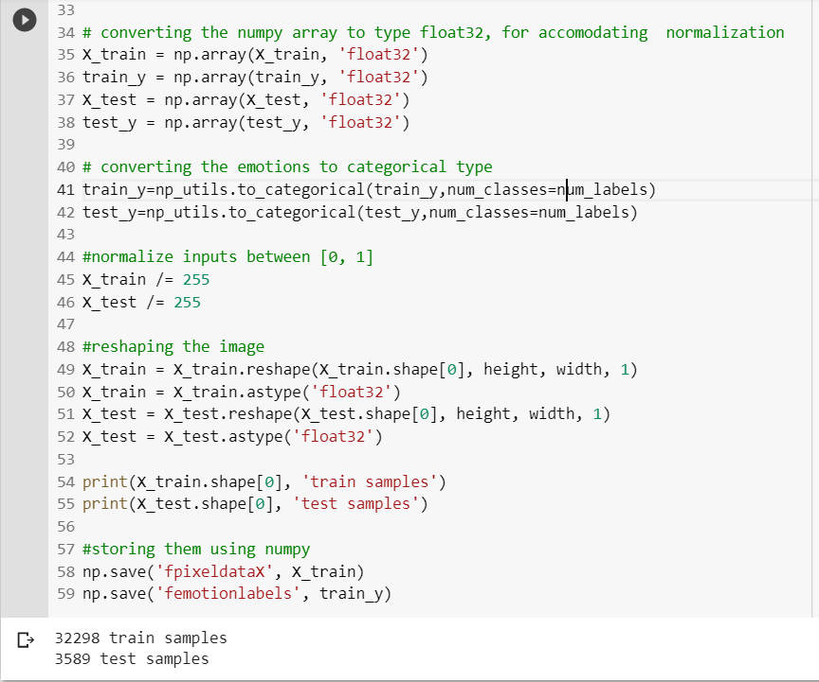
Converting the Dataset into NumPy array
Result of print statement

Slide 13
Implementation of Pre-trained Model from keras/applications
The model we are using here is “DenseNet121”, it a model trained on a data set of coloured images.
keras.applications.densenet.DenseNet121(include_top=True, weights=‘imagenet’, input_tensor=None, input_shape=None, pooling=None, classes=1000)
include_top: whether to include the fully-connected layer at the top of the network.
weights: one of None (random initialization), ‘imagenet’ (pre-training on ImageNet), or the path to the weights file to be loaded.
input_tensor: optional Keras tensor (i.e. output of layers.Input()) to use as image input for the model.
pooling: Optional pooling mode for feature extraction when include_top is False.
none : that the output of the model will be the 4D tensor output of the last convolutional block.
avg : that global average pooling will be applied to the output of the last convolutional block, and thus the output of the model will be a 2D tensor.
max : that global max pooling will be applied.
classes: optional number of classes to classify images into, only to be specified if include_top is True, and if no weights argument is specified.

Slide 14
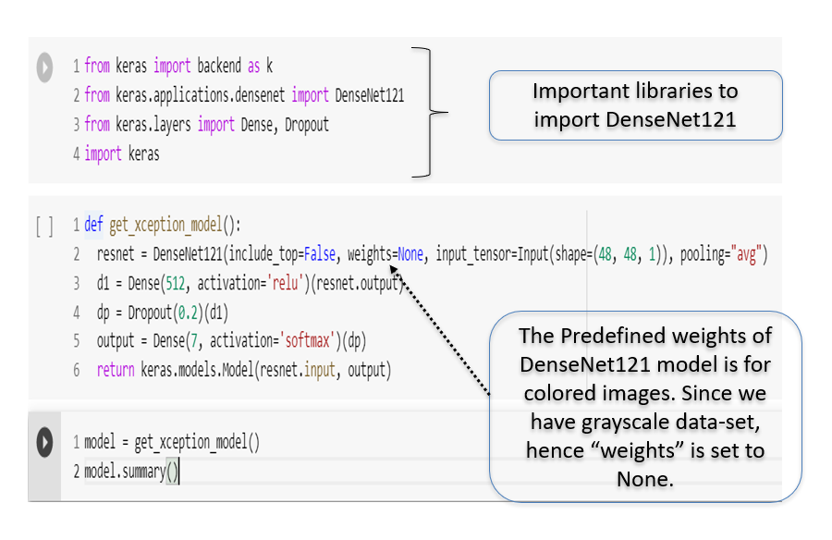
Pre-trained Model- DenseNet121

Slide 15
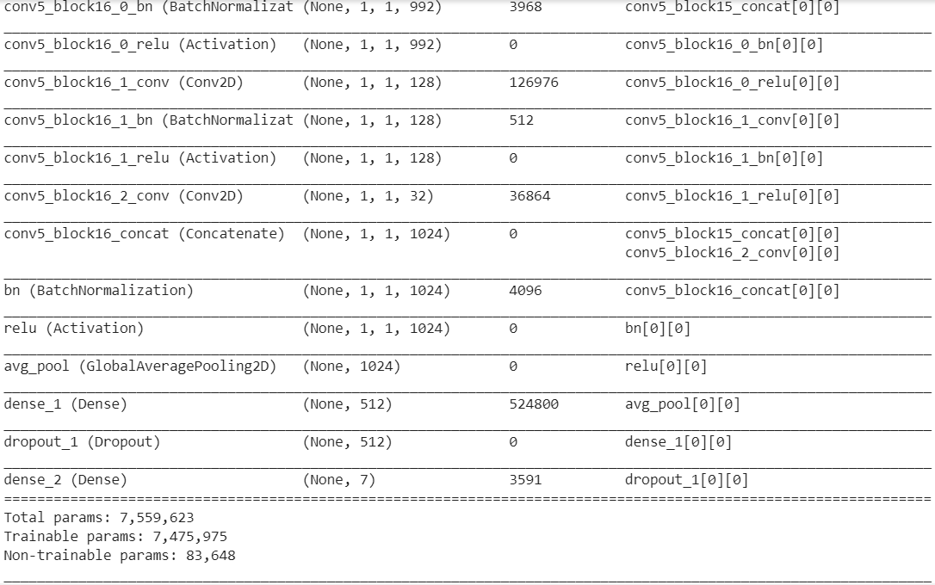
Model Summary of DenseNet121
We have not used DenseNet121, - it requires a lot of processing , which is not enquired for our dataset.
- The total trainable/nontrainable parameter count is way to high for our dataset.
Non-trainable params: The parameter which don’t get optimized while training.

Slide 16
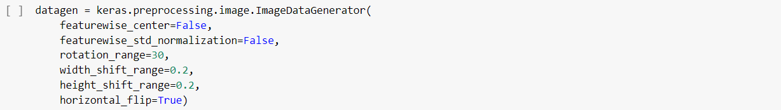
Data augmentation with keras
Data augmentation is very useful when the dataset used for training the model is comparitevly small. It significantly increase the diversity of data available for training models, by techniques such as cropping, padding, and horizontal flipping are commonly used to train large neural networks. In Keras this can be done via the keras.preprocessing.image.ImageDataGenerator class. This class allows you to: configure random transformations and normalization operations to be done on your image data during training instantiate generators of augmented image batches (and their labels) via .flow(data, labels) or .flow_from_directory(directory). These generators can then be used with the Keras model methods that accept data generators as inputs, fit_generator, evaluate_generator and predict_generator.

Slide 17
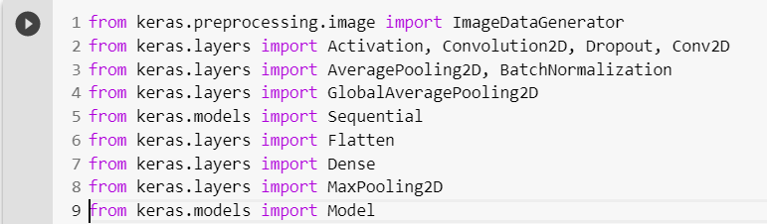
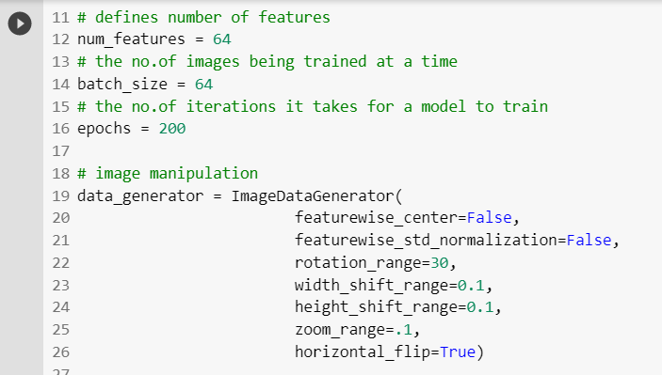
Defining Model
Importing the required libraries
Defining variable and data augmentation()

Slide 18
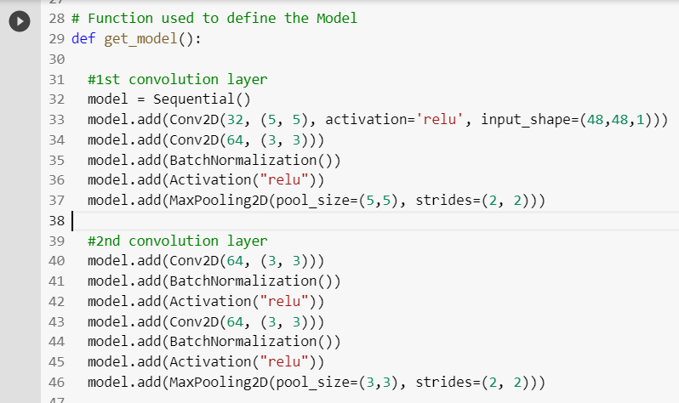
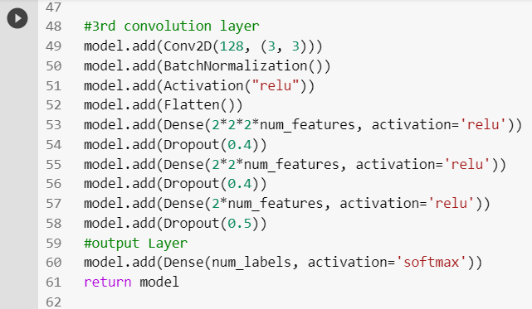
Defining Model
num_labels =7(emotions) ensures that the output layers will categorize the inputs in 7 categories.

Slide 19
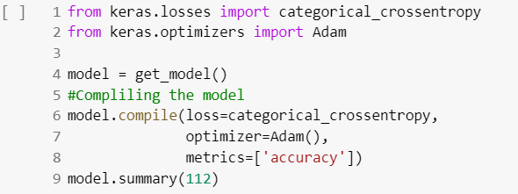
Compiling the Model
We have used loss= categorical_crossentropy, because the input data should belong to only one of the 7 emotions.

Slide 20
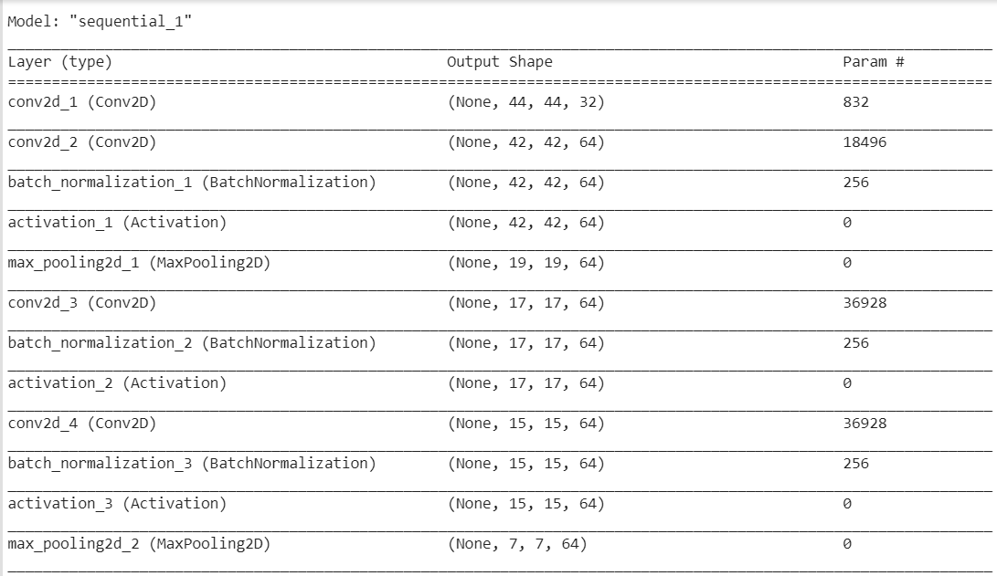
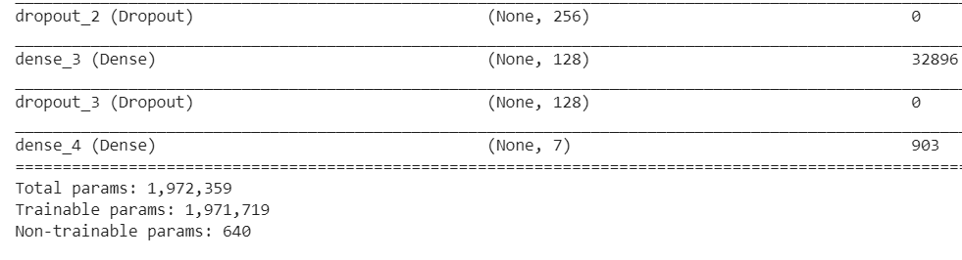
Model Summary
Param# layer 1: model.add(Conv2D(32, (5, 5), activation='relu', input_shape=(48,48,1)))
32x(5x5x1+1)=832 Param# layer 2: model.add(Conv2D(64, (3, 3)))
64x(3x3x32+1)=18496
(filter_height * filter_width * input_image_channels + 1) * number_of_filters
Non-trainable parameters, In this case could be because of BatchNormalization() which has both trainable (gamma weights, beta weights)
and non-trainable (moving_mean, moving_variance) parameters.

Slide 21
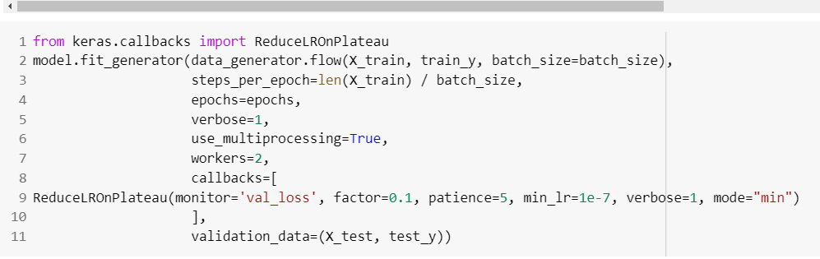
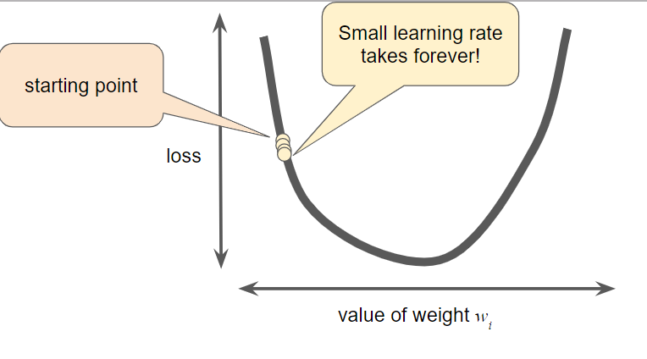
Training the Model
ReduceLROnPlateau-
Patience=5: waiting time to conclude there was no improvement in the val_loss
mode=‘min’: Learning rate will be reduced by the given factor (0.1) once the patience time is over.
Verbose =1 : update the callback logs.

Slide 22
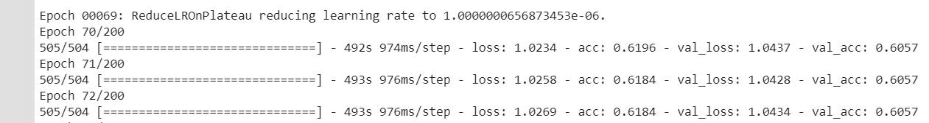
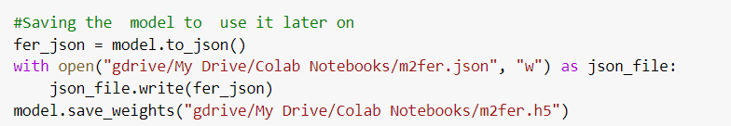
Model Accuracy
Saving Model & Weights

Slide 23
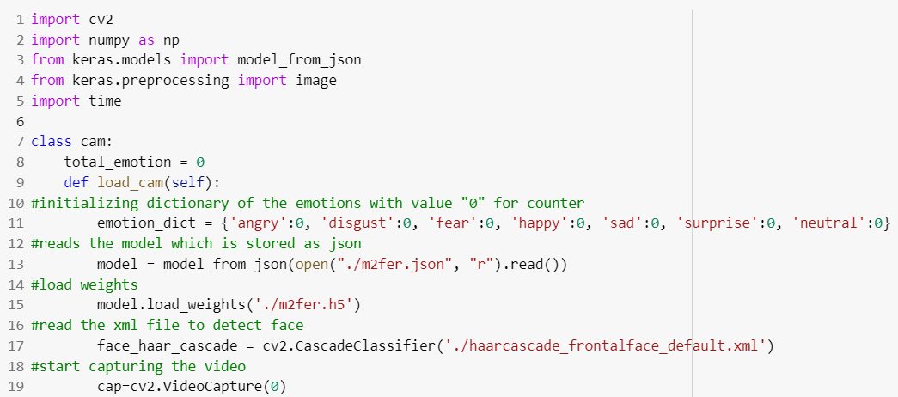
Demo file-Code
The required libraries are loaded.
Assigning all emotions 0 value, to calculate the heightened emotion.
Loaded the trained model.
Loaded the “haarcascade_frontalface” to find the face.

Slide 24
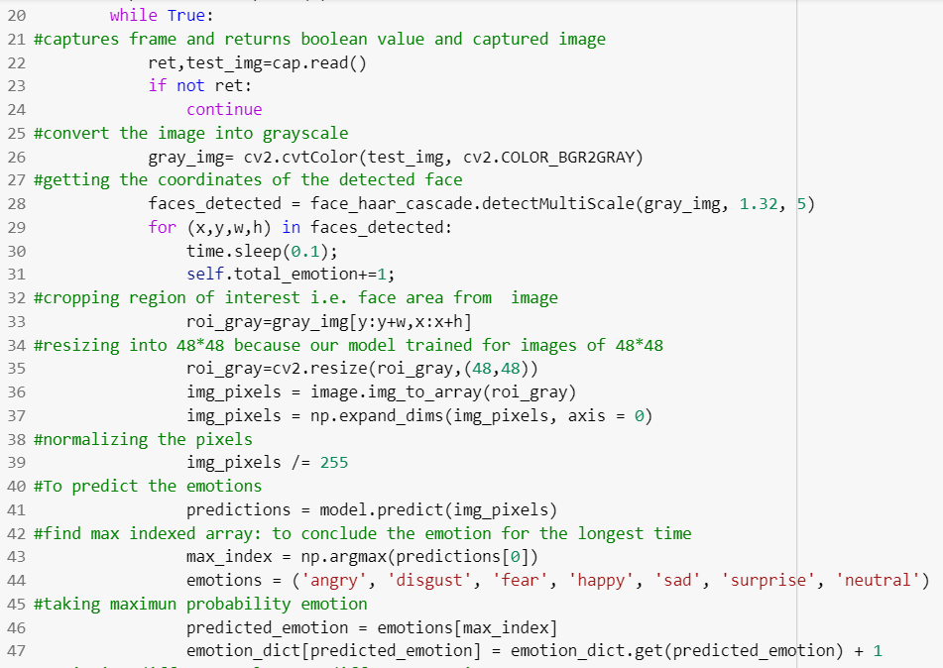
Convert the video frame to grayscale, as the model is trained with grayscale images.
Using haar_cascade to focus on the face while recognizing the emption.
Incrementing the counter of the emotion, to calculate the emotion recognized more number of times.

Slide 25
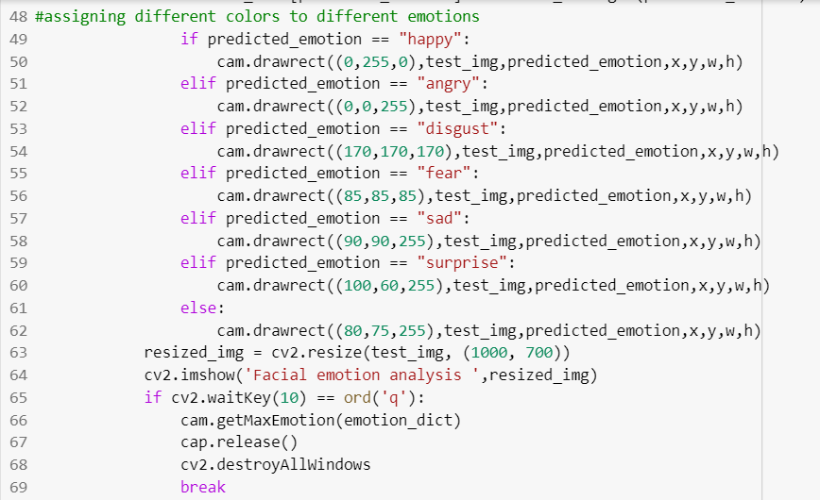
Assigning different color for each emotions.
When user presses “q” the video is terminated.
The max emotion pop-up appears.

Slide 26
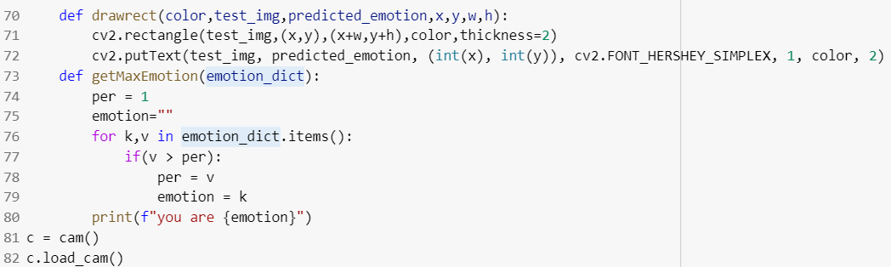
drawrect() to implement the rectangular box to display the emotion defected.
getMaxEmotion() to find the heightened emotion and display in the rectangular box.

Slide 27
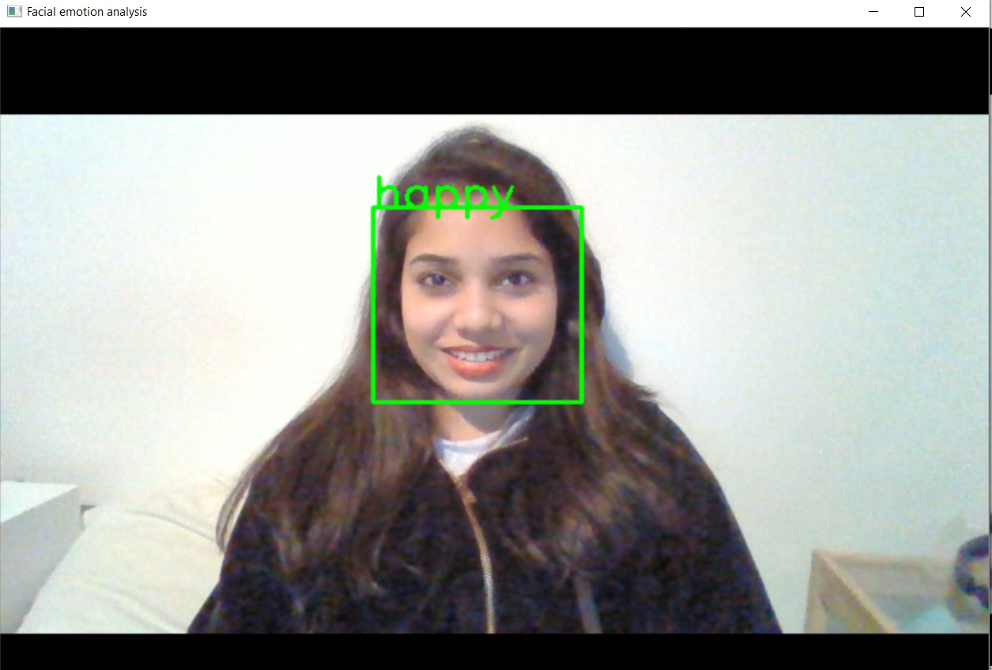
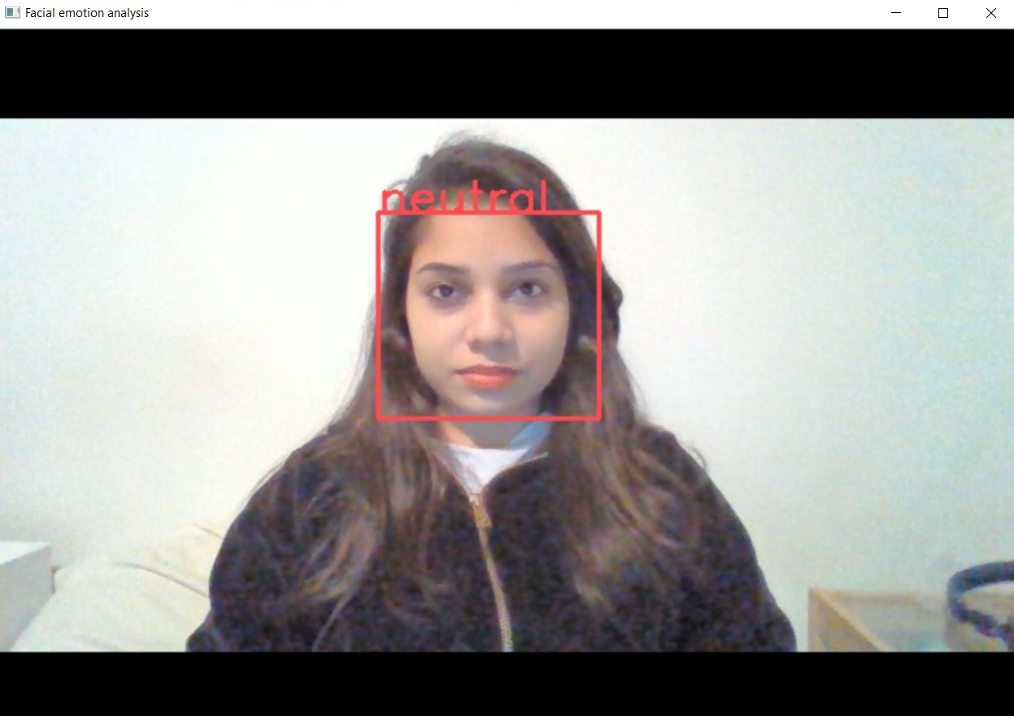
Outputs

Slide 28
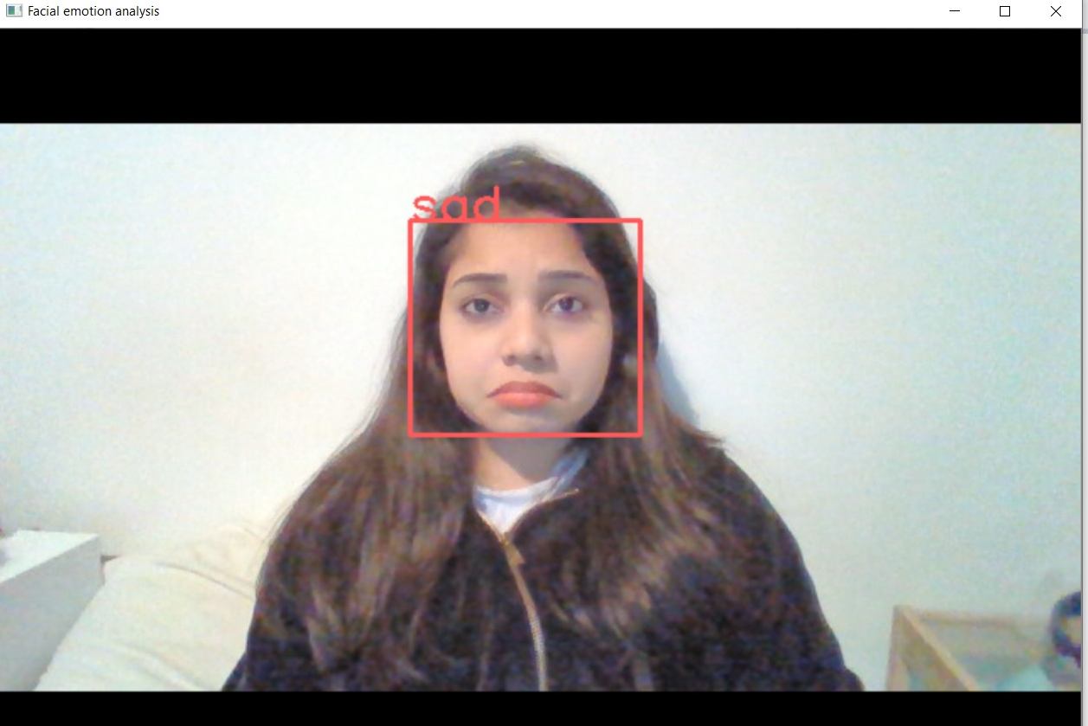
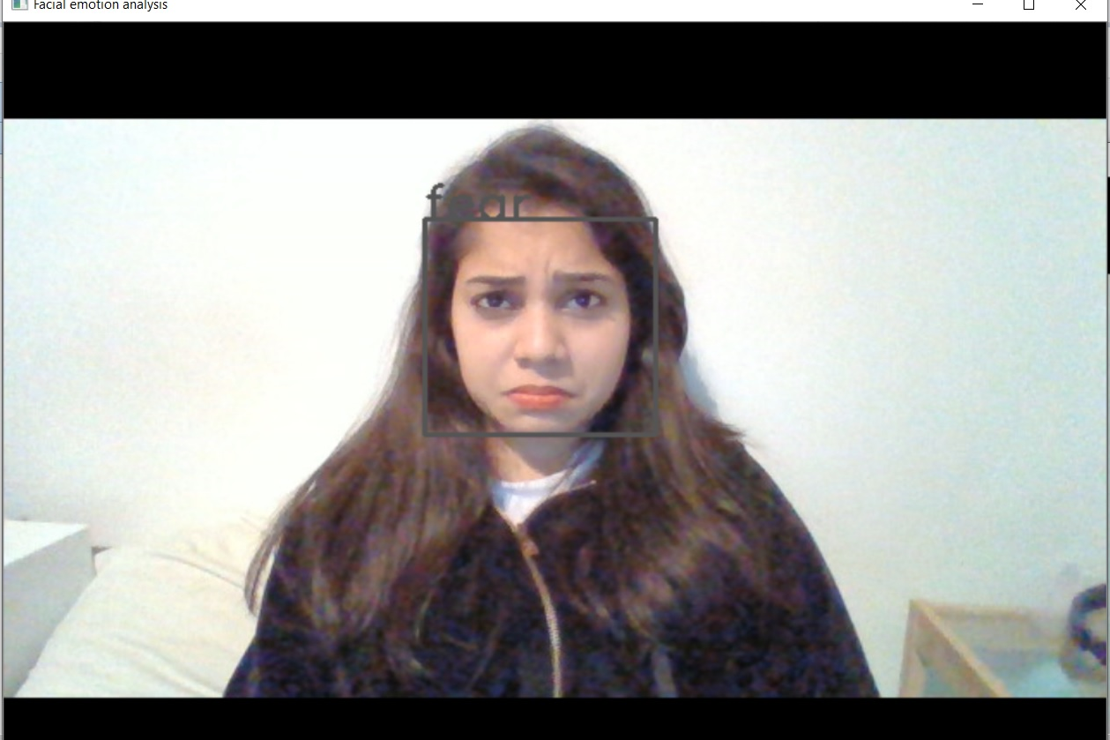
Outputs

Slide 29
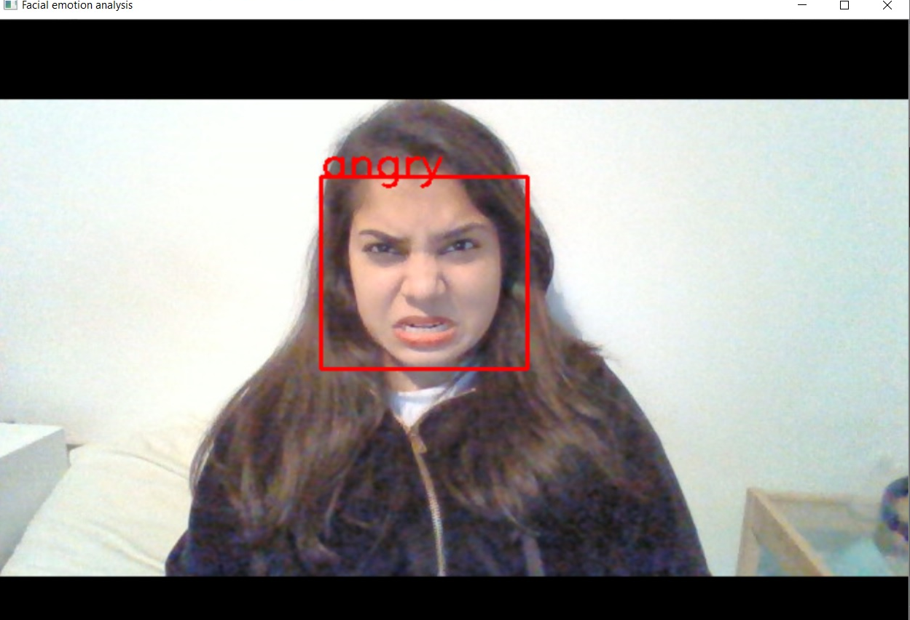
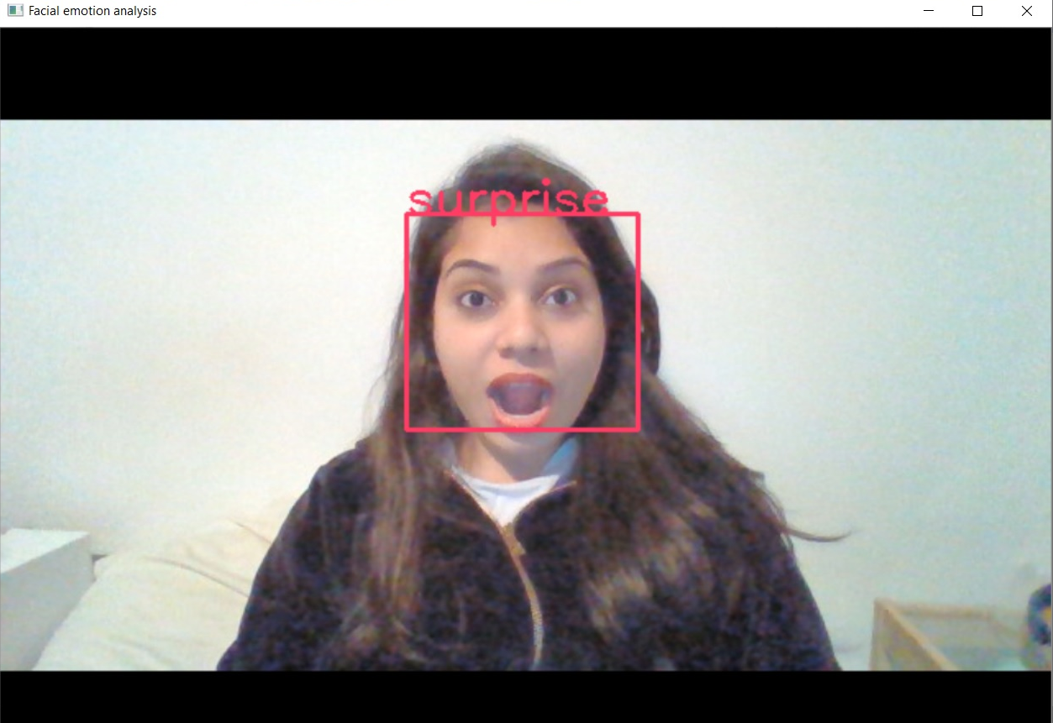
Outputs

Slide 30
Demo: Video links
Happy:
https://drive.google.com/open?id=15WyFVvVQZ4tymdn2u0DudEOyAHU6GJnd
Sad:
https://drive.google.com/open?id=1rnqUEH1JyPWG6hKgrvm1tBy4DiGPgyOk
Happy:
https://drive.google.com/open?id=13iZyFIWal3Tnj2IGwuglbv3ikxCiPPBt

Slide 31
References
https://appliedmachinelearning.blog/2018/11/28/demonstration-of-facial-emotion-recognition-on-real-time-video-using-cnn-python-keras/
http://cs231n.github.io/convolutional-networks/
https://keras.io/applications/
http://faculty.neu.edu.cn/yury/AAI/Textbook/Deep%20Learning%20with%20Python.pdf
https://towardsdatascience.com/applied-deep-learning-part-4-convolutional-neural-networks-584bc134c1e2
https://docs.opencv.org/2.4/modules/highgui/doc/reading_and_writing_images_and_video.html
https://pandas.pydata.org/pandas-docs/stable/
https://keras.io/

